Slide 1
Application of the SlicerRT toolkit for image-guided radiation therapy research
Csaba Pinter¹, Andras Lasso¹, An Wang², David Jaffray², and Gabor Fichtinger¹
¹Laboratory for Percutaneous Surgery, Queen’s University, Canada ²University Health Network, Toronto, ON, Canada

Slide 2
SparKit project overview
Goal: provide open-source platform for translational clinical research, mainly cancer
Funding by Cancer Care Ontario till 2016
PI & co-PI: Gabor Fichtinger (Queen’s), David Jaffray (Toronto UHN), Terry Peters (Robarts)
Themes:
SlicerRT: radiotherapy toolkit for 3D Slicer
SlicerIGT: Image-guided therapy with 3D Slicer

Slide 3
SlicerRT theme overview
Motivation:
commercial treatment planning software: closed, expensive
existing research tools (CERR, PLUNC, dicompyler, etc): limited
Goal:
“hub” for RT data analysis and comparison
Free, open-source, BSD license
Approach:
leverage existing tools and parallel efforts
3D Slicer
RT import (DICOM)
Visualization (volumes, models, 2D/3D, etc.)
Processing (registration, segmentation, etc.)
Analysis (error metrics, measurements, image fusion, etc.)
RT-specific analysis (dose comparison, DVH, …)
RT export (DICOM, Matlab, …)
Notes:
Use 3DSlicer as platform
DICOM-RT data import: mapping RT data structures to existing 3DSlicer data types
Utilize existing 3DSlicer features: registration, visualization, ...
Develop missing RT-specific functionalities: DVH analysis, ...
Export results to commercial treatment planning system or research software (Matlab, etc.)

Slide 4
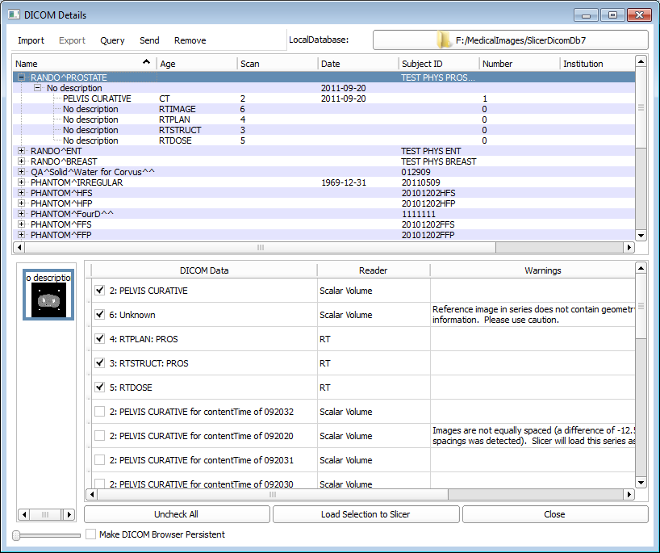
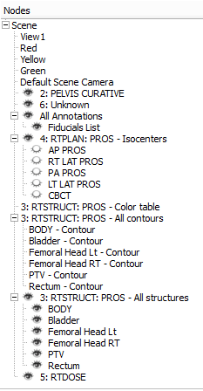
DICOM-RT import module
Integrated into core DICOM import module
Mapping to existing structures:
Structure sets -> surface model (planar contour ROI), -> fiducial point (point ROI)
Dose map -> scalar volume
RT image -> scalar volume
Planning CT, MR, etc. -> scalar volume
RT plan -> isocenter positions
DICOM browser
Data imported into MRML nodes

Slide 5
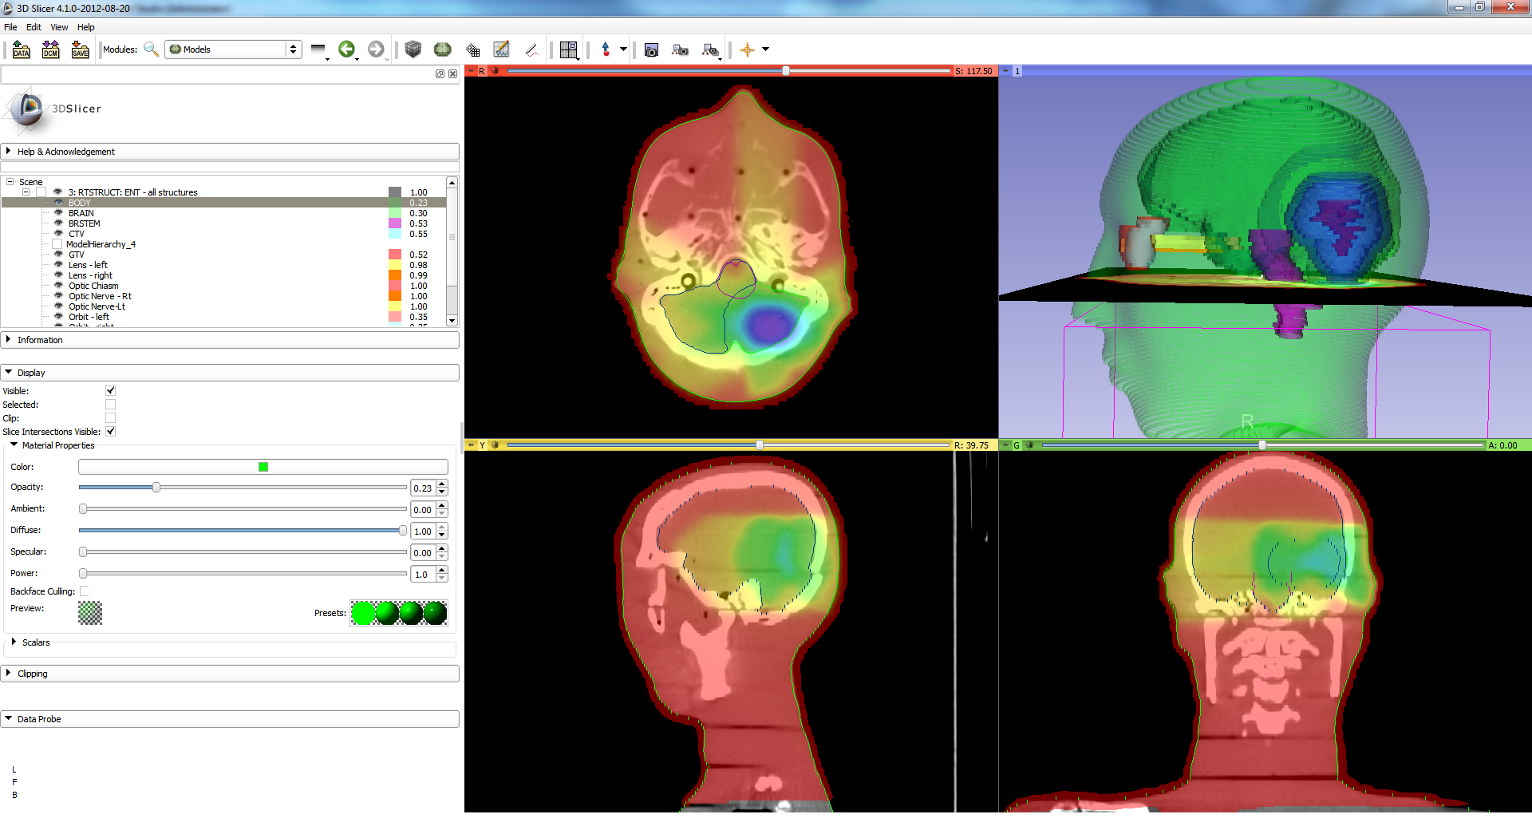
DICOM-RT import example

Slide 6
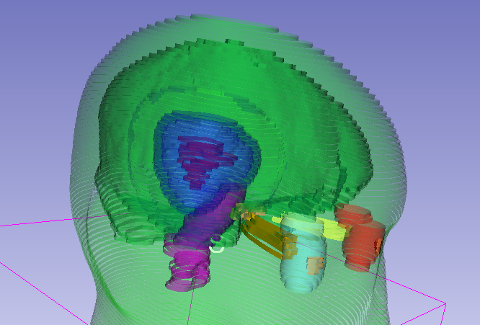
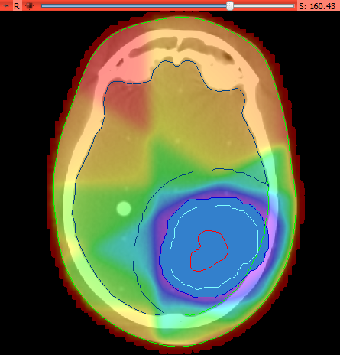
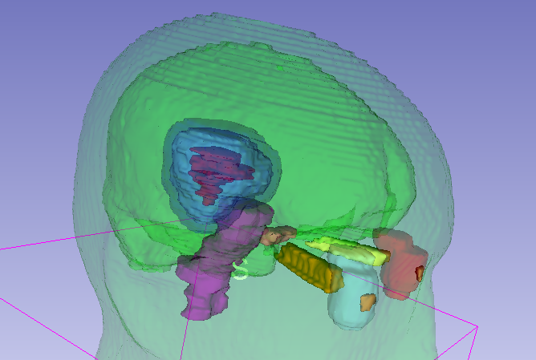
Structure set representation
Ribbon surface model
(after import)
Closed surface model
Labelmap volume

Slide 7
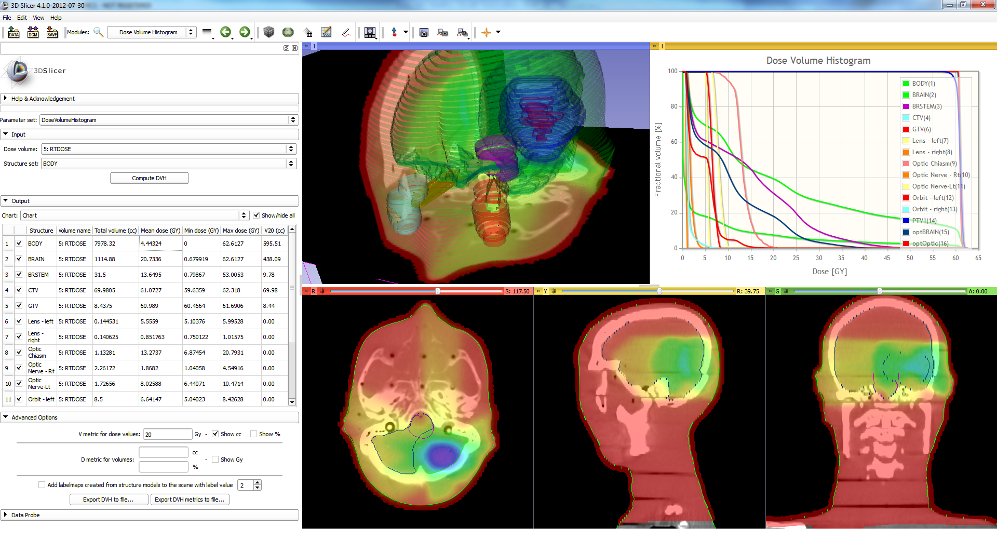
Dose Volume Histogram module

Slide 8
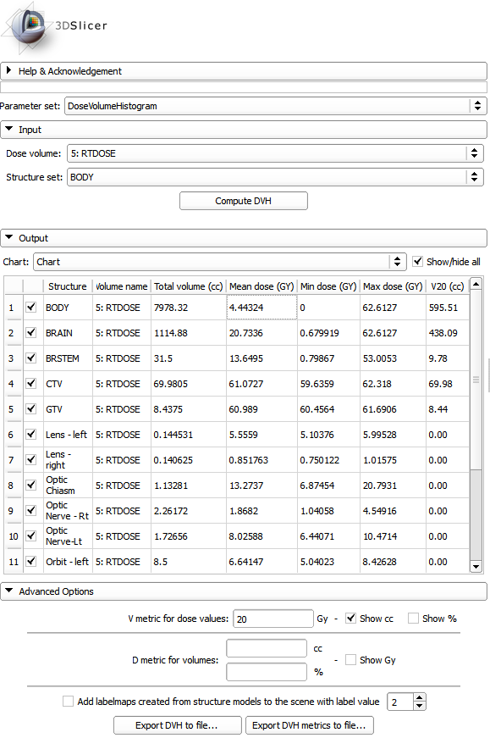
Dose metrics
Available metrics:
Total volume
Min, max, mean dose
V metrics: for user-defined levels, results in cc and %
D metrics: for user-defined levels in cc and %
Values can be exported to CSV file for further analysis.

Slide 9
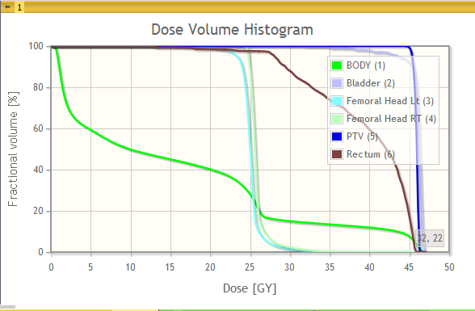
DVH plot
Zoom, trace, etc.
Bin values can be exported CSV file

Slide 10
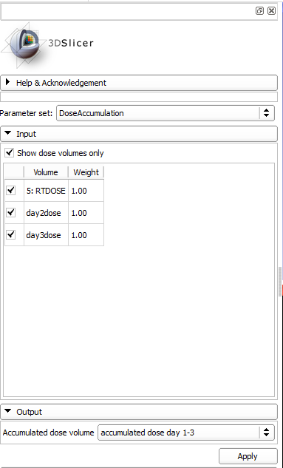
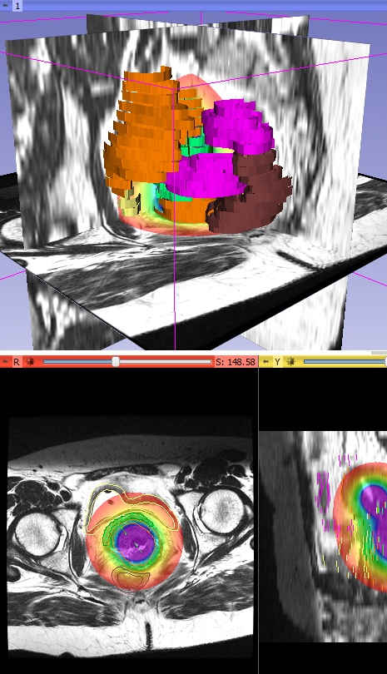
Dose accumulation module
Computes a weighted sum of selected dose volumes.

Slide 11
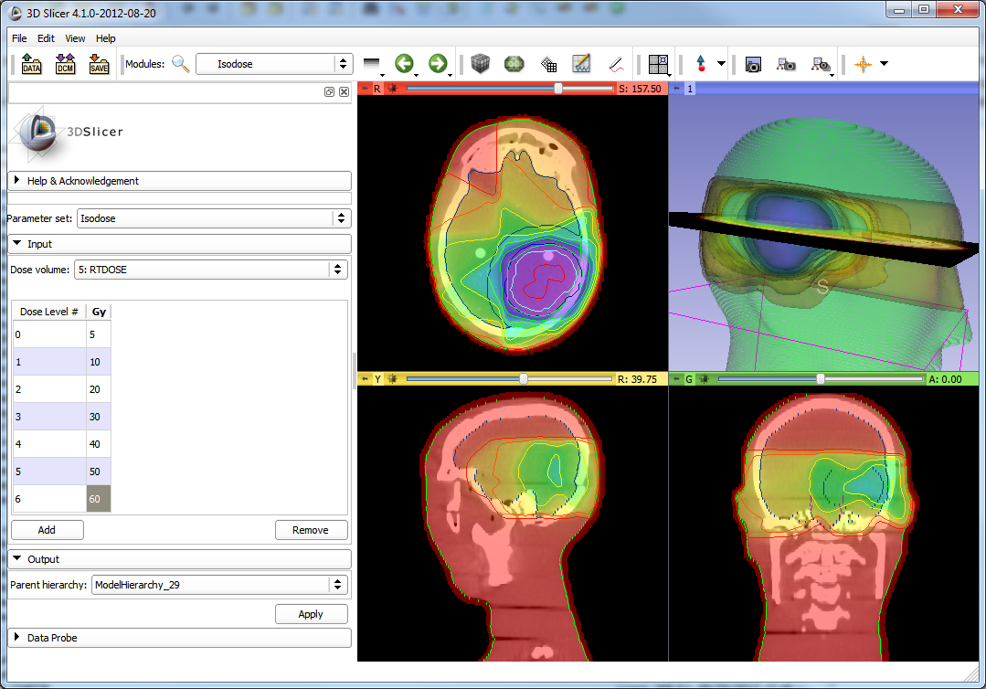
Isodose module
Creates isosurface from a dose volume and a series of isodose levels

Slide 12
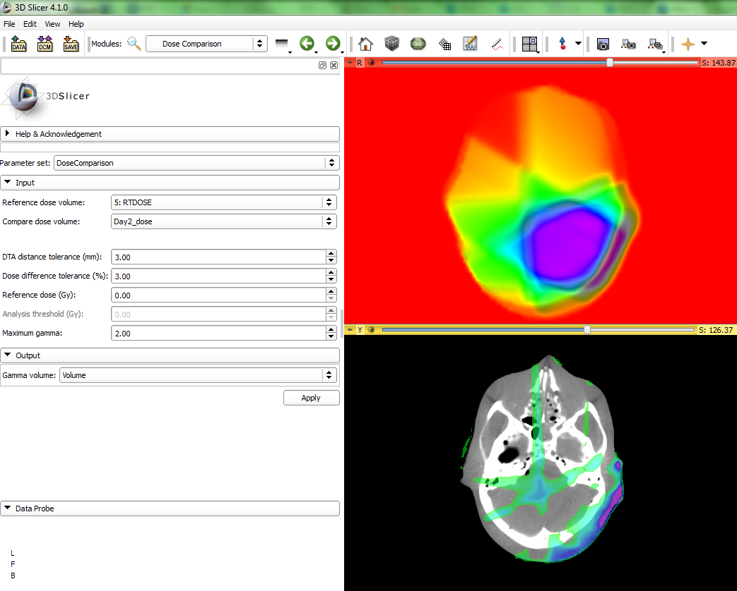

Dose comparison module
Computes dose difference using 3D gamma function
Powered by

Slide 13
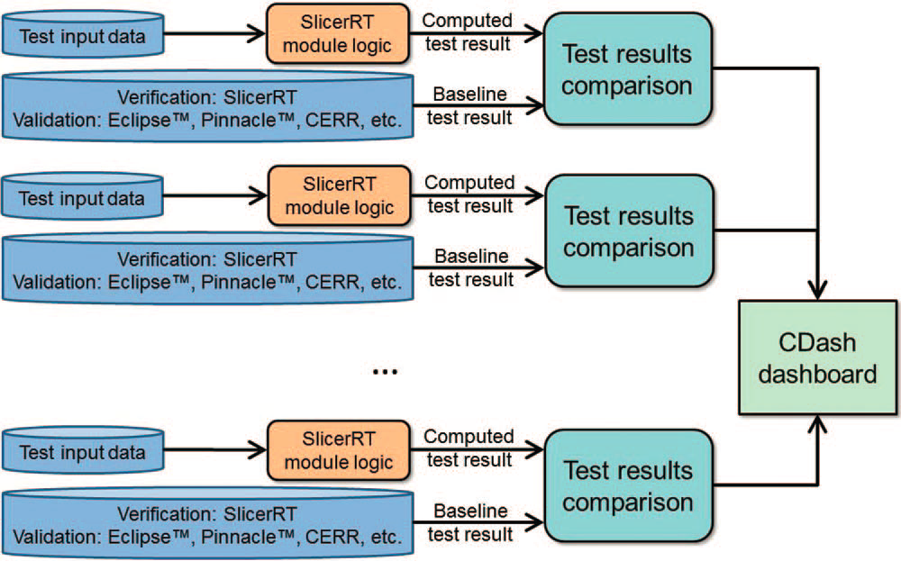
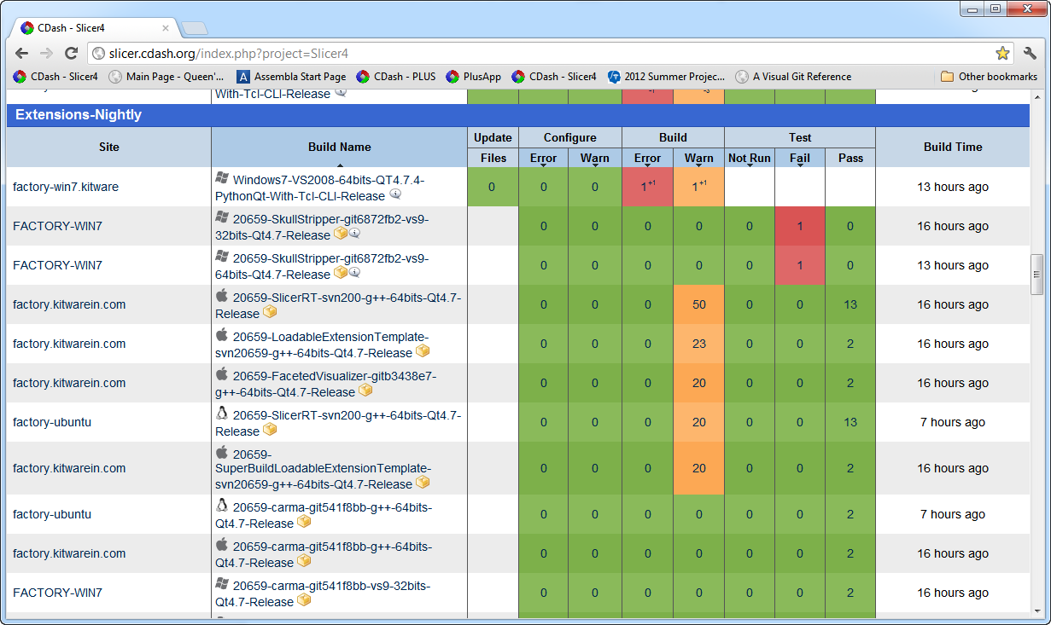
Verification and validation
Extensive automatic testing done on multiple platforms
Validated against other software packages (Pinnacle, CERR, …)
Automatic test infrastructure for automatic verification and validation
Test results reported to the web-based dashboard
http://slicer.cdash.org/index.php?project=Slicer4

Slide 14
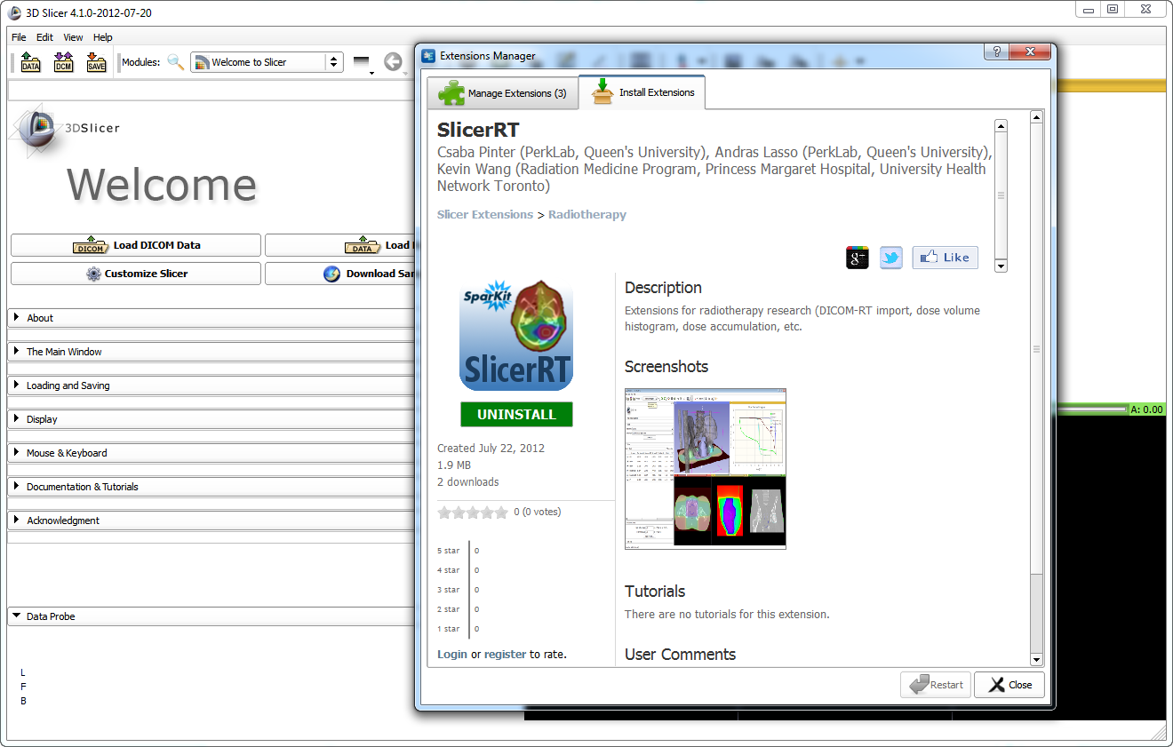
SlicerRT extension for 3D Slicer
Collection of RT-specific modules, includes
Distributed as a 3D Slicer extension: can be downloaded, installed, upgraded using the extension manager in Slicer
SlicerRT extension in the 3D Slicer app store (free)

Slide 15
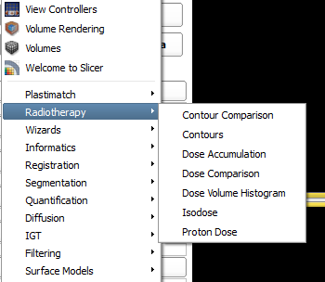
Next steps
Planned developments for the next 6 months:
Contour representation generalization, convenient conversions
Plastimatch module GUI improvements: structure set comparison, 2D/3D registration, landmark-based deformable registration, digitally reconstructed radiograph (DRR) generation, etc.
Scripting examples
Export to DICOM-RT, Matlab
More testing and validation
Current radiotherapy modules (including work-in-progress modules)
Detailed plan: https://www.assembla.com/spaces/slicerrt/tickets

Slide 16

Thank you!
Overview paper: Csaba Pinter, Andras Lasso, An Wang, David Jaffray, and Gabor Fichtinger, “SlicerRT: Radiation therapy research toolkit for 3D Slicer”, Med. Phys. 39 (10), October 2012
Project homepage: https://www.assembla.com/spaces/slicerrt/
Contact: Andras Lasso (lasso@cs.queensu.ca)

